Slide 1
Safe Alone
“Bear the burden of solitary”
Hung Hong – IMGD 2000

Slide 2
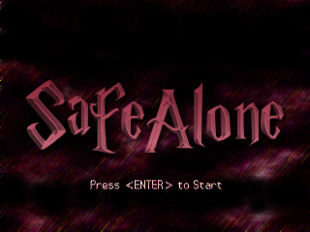
Title Screen

Slide 3
Story & Goal
You are home alone, and your parents are not around…
That means you have to take care of everything around the house BY YOURSELVES
Resolve issues around the house until you are confident to finalize your houseworks
Learn basic independence skills and tips for staying alone.
Be vigilant!

Slide 4
Survey Results
More Rooms
Last 5 - 7 mins
Inventory System
Challenging Gameplay
More info: [LINK]

Slide 5
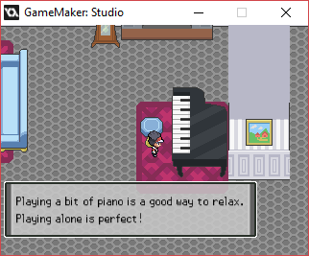
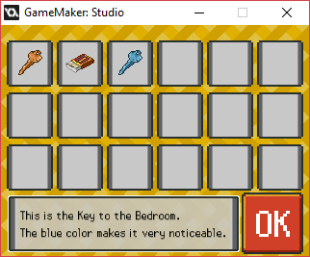
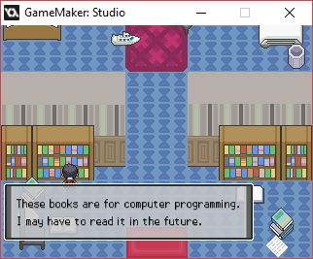
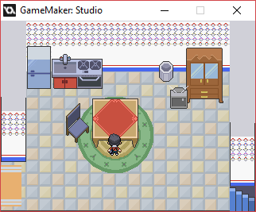
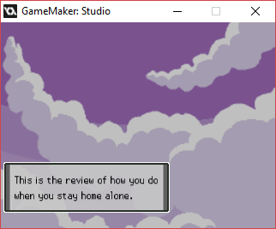
Live Demonstration

Slide 6
About the Game itself
Control: Up, Down, Left, Right
Interacting with Objects: <SPACE>
Menu: <ENTER>
Inventory System: Mouse

Slide 7

About the Game itself
Engine: GameMaker
Target: Age 5+
Art: Pixel 2D work
Character: Me
Tilesets: Akizakura16 (DeviantArt: http://akizakura16.deviantart.com/)
Title Screen: Me
Final Screen: Modified from Pokemon Platinum background

Slide 8
Make it better…
Sound System:
Background musics
SFXs
Minigames in some missions:
E.g. cooking…
Settings:
Faster/Slower Text
Textbox Style
Animations:
Traveling between rooms
Cutscenes

Slide 9
Any questions?

